Slide 1
CS 4215: Quantitative Performance Evaluation for Computing ystems
Lydia Y. Chen
y.chen-10@tudelft.nl

Slide 2
Google Page Rank

Slide 3
Ethernet

Slide 4
Server Failure

Slide 5
Energy Management for Cloud

Slide 6
Last week
Operational Laws
Littles Law
Forced Law
Utilization Law
Asymptotic Bounds

Slide 7
Discrete-Time Markov Chain

Slide 8
Stochastic process
Stochastic process:
Definition: a collection of random variables indexed by some set.
Category by the type of index
Continuous event
Discrete event
Markov property: it is not necessary to know how long the process has been in the current state
Markov chain
Discrete event stochastic process
Stochastic Process
Discrete events
Discrete Time
(DTMC)
Continuous Time
(CTMC)
Continuous events

Slide 9
Overview
Model
State
Transition probability
Solving
Limiting v.s. stationary distribution
Theorem
Erogodicity theorems
Finite to infinite states

Slide 10
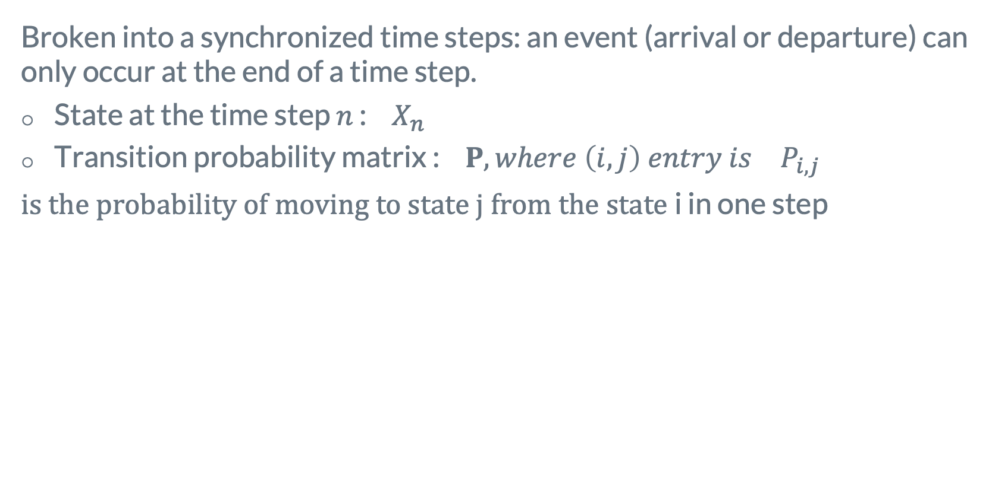
Discrete Time Markov Chains
Broken into a synchronized time steps: an event (arrival or departure) can only occur at the end of a time step.
State at the time step $n$ : ${ X}_{n}$
Transition probability matrix : ${{ Ρ, where \left(i,j\right) entry is }_{}P}_{i,j}$
$is the probability of moving to state j from the state$i in one step
Markovian Property

Slide 11
Example of Repair Facility
A machine is either working or in the repair center. If it’s working today, then there is a 95% chance it will be working tomorrow. If it’s in the repair, there is a 40 % chance it will be working.
Q: what fraction of time does the machine spend in the repair shop?
Ans: two states of “working” and ”broken”.
Transition probability
Markov
chain

Slide 12
Example of Program Analysis
A Program has three types of instructions: CPU (C), memory (M), and User interactions (U).
C instruction with probability 0.7 is followed by another C instruction, with 0.2 probability by an M instruction, and with probability 0.1 by a U instruction.
M instruction with probability 0.8 is followed by another C instruction, with 0.1 probability by an M instruction, and with probability 0.1 by a U instruction.
U instruction with probability 0.9 is followed by another C instruction, with 0.1 probability by an M instruction, and with probability 0 by a U instruction.
Transition probability
Markov
chain

Slide 13
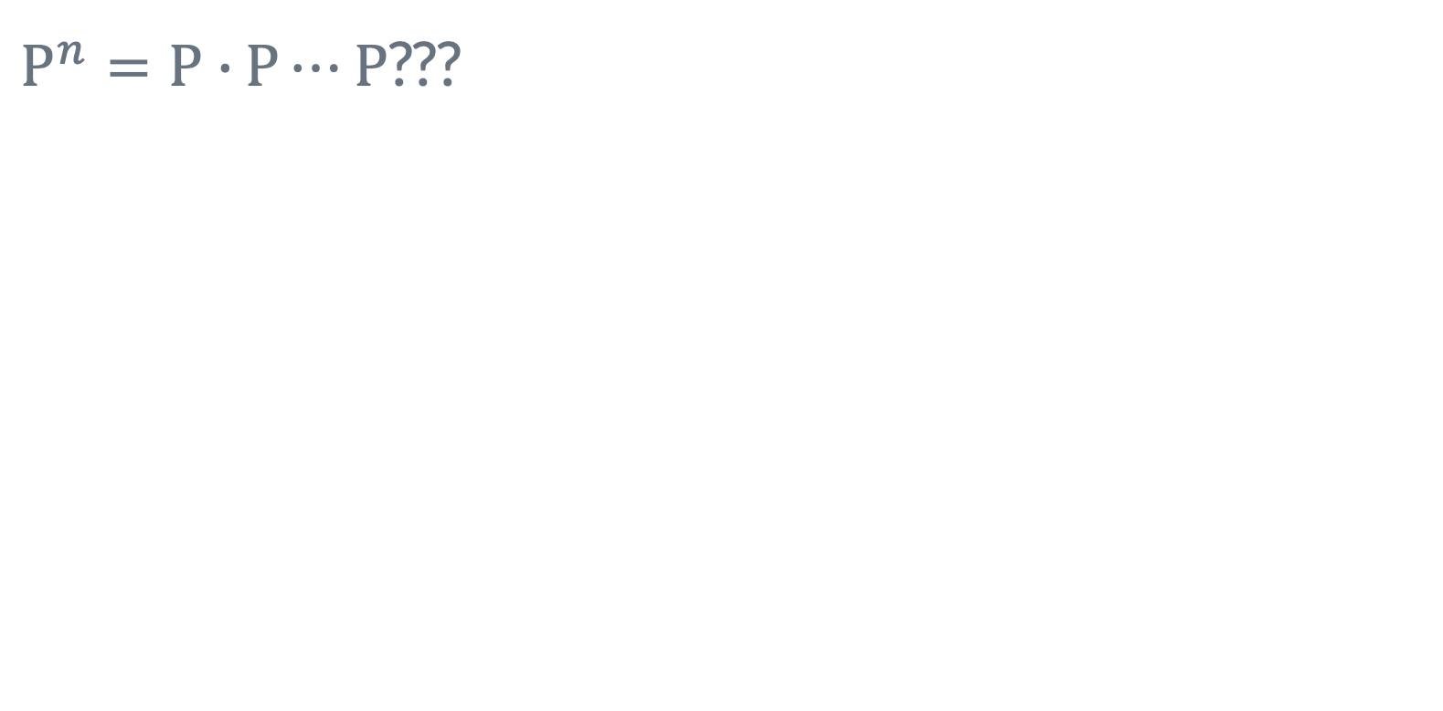
Limiting probabilities
Observation:
All the rows become the same
$Ρ^{n}=Ρ∙$ $Ρ⋯$ $Ρ$???
Definition
Q. What does it says about all rows are the same?
A: starting state (i) does not matter

Slide 14
Limiting probabilities
Observation:
All the rows become the same
$Ρ^{n}=Ρ∙$ $Ρ⋯$ $Ρ$???
Definition
Q. What does it says about all rows are the same?
A: starting state (i) does not matter

Slide 15
Limiting probabilities
Observation:
All the rows become the same
$Ρ^{n}=Ρ∙$ $Ρ⋯$ $Ρ$???
Definition
Q. What does it says about all rows are the same?
A: starting state (i) does not matter

Slide 16
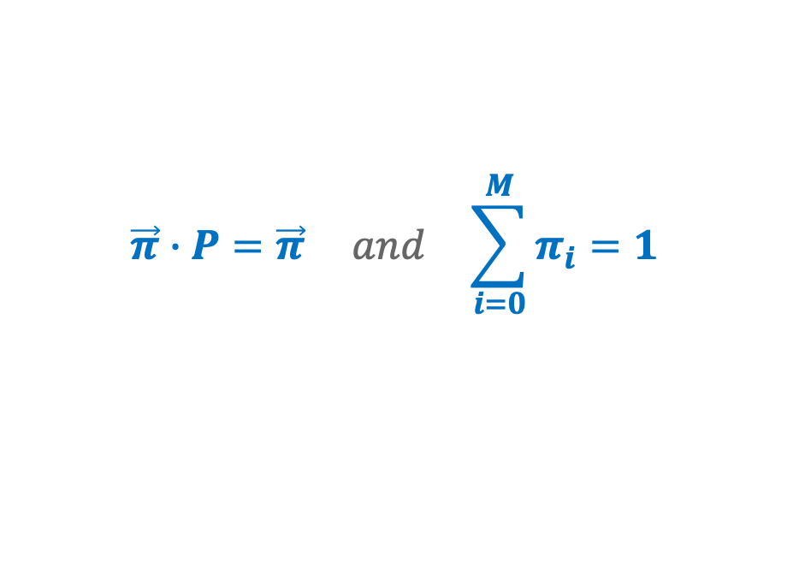
Limiting Distribution
Multiplying P by itself multiple times is onerous !!!
A probability distribution is said to be stationary for the Markov chain if
$$\vec{π}∙Ρ=\vec{π} and \sum_{i=0}^{M}{π_{i}=1}$$

Slide 17
Limiting distribution = stationary distribution
How can we assume so?
Proof: see chapter 8

Slide 18
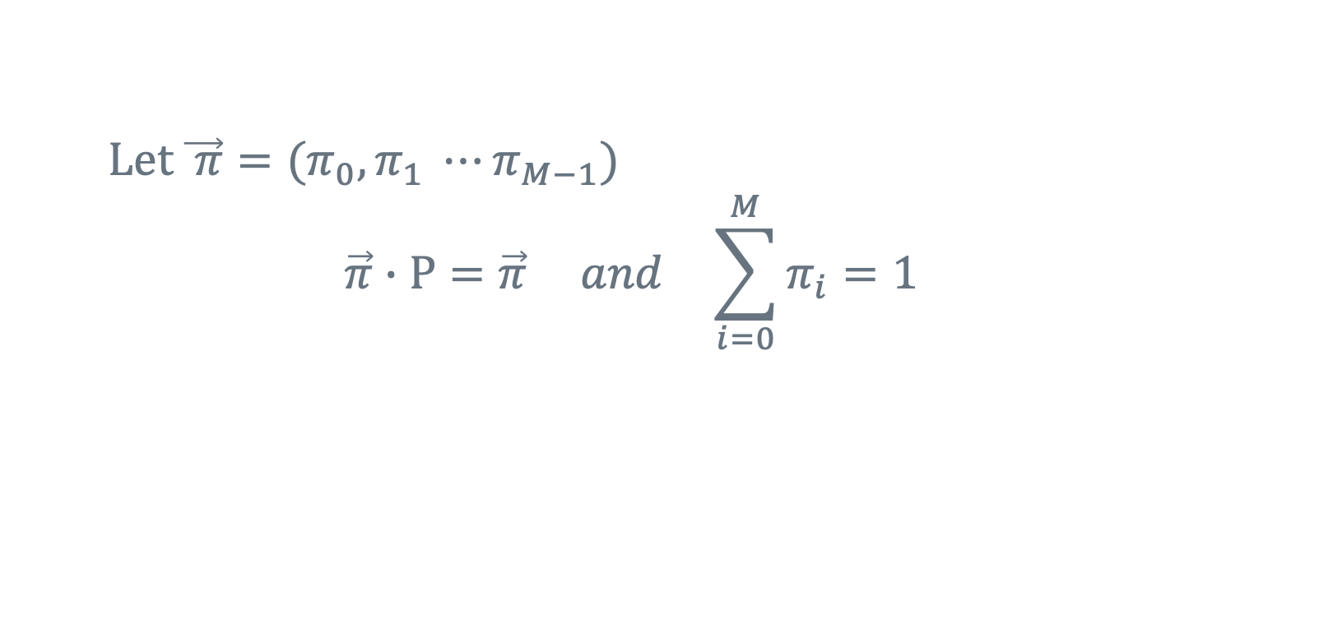
Solving Limiting Distribution
$Let \vec{ π}=(π_{0},π_{1} ⋯π_{M−1})$
$$\vec{π}∙Ρ=\vec{π} and \sum_{i=0}^{M}{π_{i}=1}$$
Back to the example of repair
Observation:
First two eq. are identical

Slide 19
Google Page Rank
A good search engine is to rank “many” pages such that the relevant ones likely fall within the top 10 of the list
➔ Rank page according to the number of links to that page (so called backlinks of the page)

Slide 20


Example of Aloha Protocol
Progenitor of the Ethernet protocol, a datalink-level protocol
Allows m users to transmit a data frame along a single wire with a probability p
Only one user can use a wire at a time
Collision: more than one users tried at the same time, and all messages corrupted
Retransmission: every unsuccessful message can retransmit with probability q
$$Ρ$$
$$Ρ$$

Slide 21
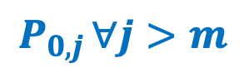
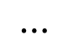

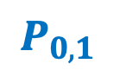

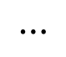
Modeling Aloha as DTMC
States!
Transition probability!!
Number of messages remaining in the system
$$P_{0,0}$$
…
$$P_{0,1}$$
0
1
$$P_{0,j }∀j>m$$
$$⋯$$
m+1
2
m
$$⋯$$
$$P_{0,j }∀j=2..m$$

Slide 22
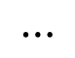
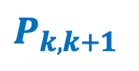
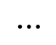
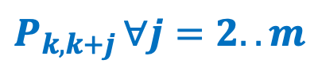
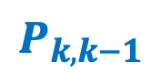
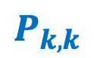
Modeling Aloha as DTMC
States!
Transition probability!!
Number of messages remaining in the system
$$P_{k,k}$$
$$P_{k,k−1}$$
k+1
k
k-1
$$⋯$$
$$P_{k,k+1 }$$
2
m
$$⋯$$
$$P_{k,k+j }∀j=2..m$$

Slide 23
k➔k-1: no new transmission and 1 retransmission
k➔k:
One new transmission, no retransmissions
No new transmission and retransmission
No new transmission and at least 2 retransmissions
k➔k+1:one new transmission and at least 1 retransmission
K➔k+j: j new transmission

Slide 24
Modeling Aloha as DTMC
Does Aloha protocol work well?
The probability of going to lower state tends to zero
The probability of staying at the same state tends to a small constant
With high probability moving to a higher stte
Can we improve it further?
Make q really small?
Today’s Ethernet design: exponential backoff

Slide 25
Bonus quiz
Write a numerical program that can model Aloha protocol for any given p, m, and q
Try to be as efficient as possible.

Slide 26
Assuming that the limiting distribution exits,
Limiting distribution = Stationary distribution
When can we assume so?
What if such a condition does not hold?

Slide 27

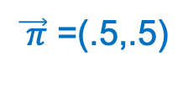
A counter example
Does it have limiting distribution?
Doe it have stationary distribution?
$$\lim_{n→∞}{P_{j,j}^{n } v.s. \lim_{n→∞}{P_{j,j}^{2n }}}$$
$\vec{ π}$ =(.5,.5)

Slide 28
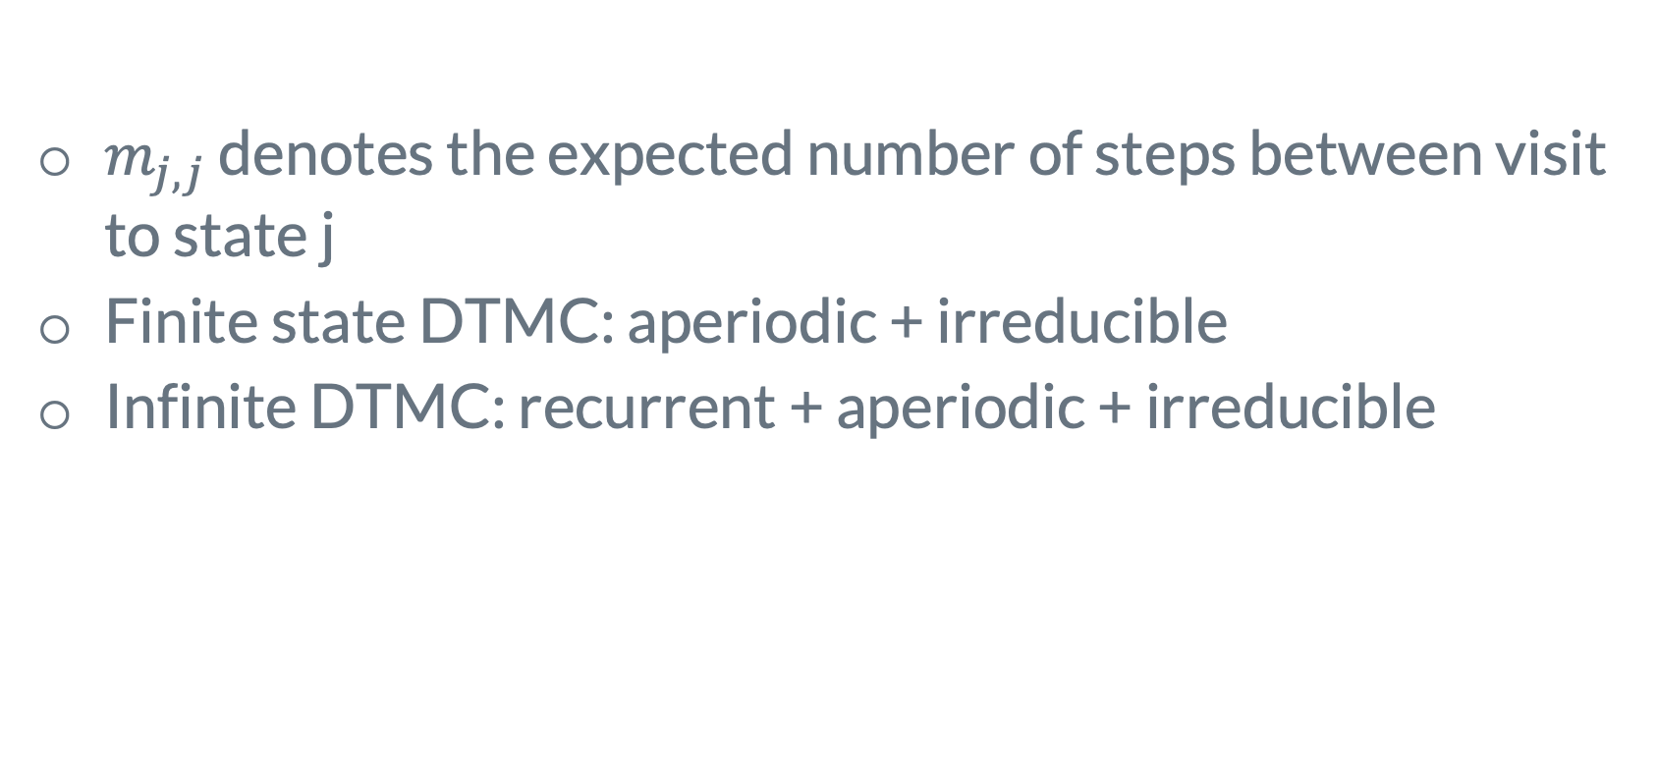
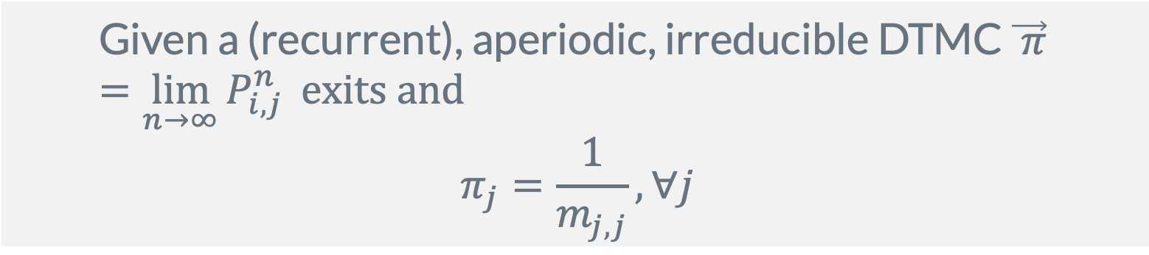
Ergocity theorem
$$\text{Given} \text{a}\text{ (}\text{recurrent}\text{)}\text{, }\text{aperiodic}\text{, }\text{irreducible} \text{DTMC} \vec{ π}=\lim_{n→∞}{P_{i,j}^{n }} \text{exits} \text{and}$$
$$π_{j}=\frac{1}{m_{j,j}}, ∀j$$
$m_{j,j}$ denotes the expected number of steps between visit to state j
Finite state DTMC: aperiodic + irreducible
Infinite DTMC: recurrent + aperiodic + irreducible

Slide 29
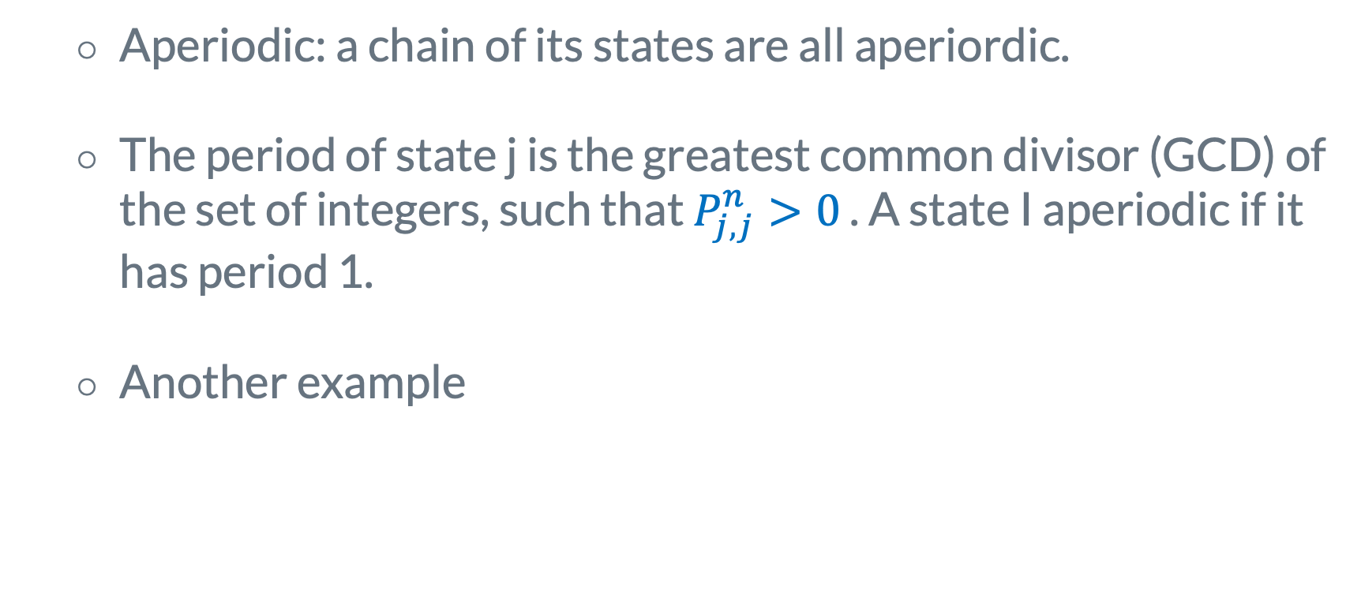
Aperiodicity
Aperiodic: a chain of its states are all aperiordic.
The period of state j is the greatest common divisor (GCD) of the set of integers, such that $P_{j,j}^{n}>0$ . A state I aperiodic if it has period 1.
Another example
What is period?

Slide 30
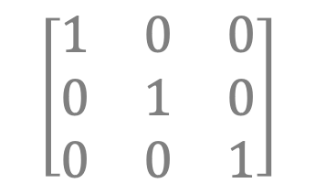
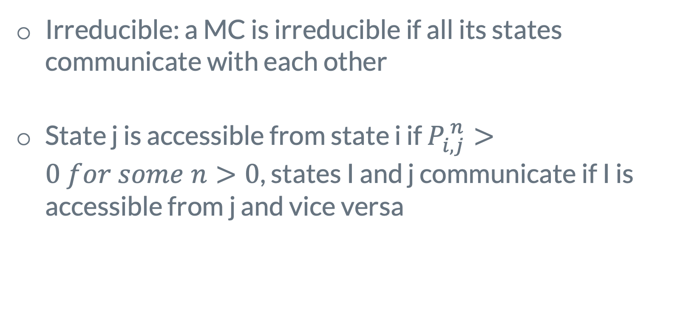
Irreducible
Irreducible: a MC is irreducible if all its states communicate with each other
State j is accessible from state i if $P_{i,j}^{ n}>0 for some n>0$, states I and j communicate if I is accessible from j and vice versa
What matrix is not irreducible?
$$\left[\begin{matrix}1 & 0 & 0 \\ 0 & 1 & 0 \\ 0 & 0 & 1\end{matrix}\right]$$

Slide 31
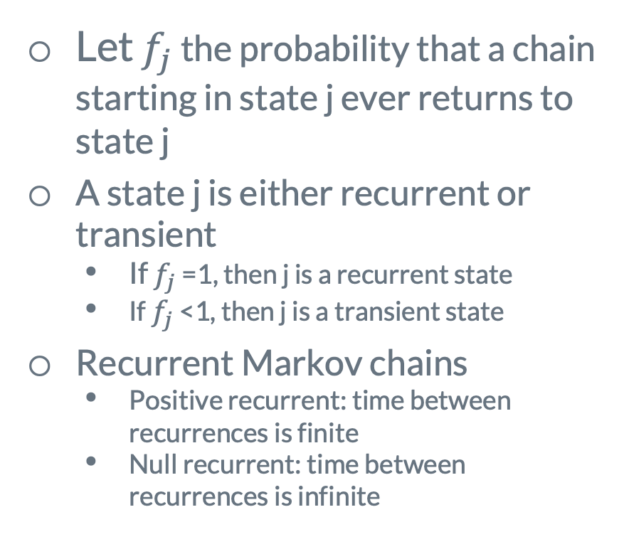
Positive Recurrent
Theorem
Definition
Let $f_{j}$ the probability that a chain starting in state j ever returns to state j
A state j is either recurrent or transient
If $f_{j}$ =1, then j is a recurrent state
If $f_{j}$ <1, then j is a transient state
Recurrent Markov chains
Positive recurrent: time between recurrences is finite
Null recurrent: time between recurrences is infinite
Theorem: With the probability 1 , the number of visits to a recurrent state is infinite. With probability 1, the number of visits to a transient state is finite.
Theorem: for a irreducible MC, either all state are transient or all recurrent
Theorem: for a transient Markov chain the limiting distribution does not exist

Slide 32
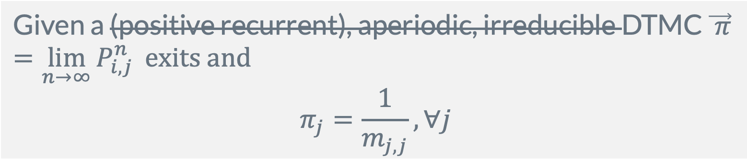
What if…..
The chain is not positive recurrent?
The chain is periodic?
The chain is reducible?
$$\text{Given} \text{a}\text{ (}\text{positive} \text{recurrent}\text{)}\text{, }\text{aperiodic}\text{, }\text{irreducible} \text{DTMC} \vec{ π}=\lim_{n→∞}{P_{i,j}^{n }} \text{exits} \text{and}$$
$$π_{j}=\frac{1}{m_{j,j}}, ∀j$$

Slide 33
Different Views of Limiting Distribution

Slide 34
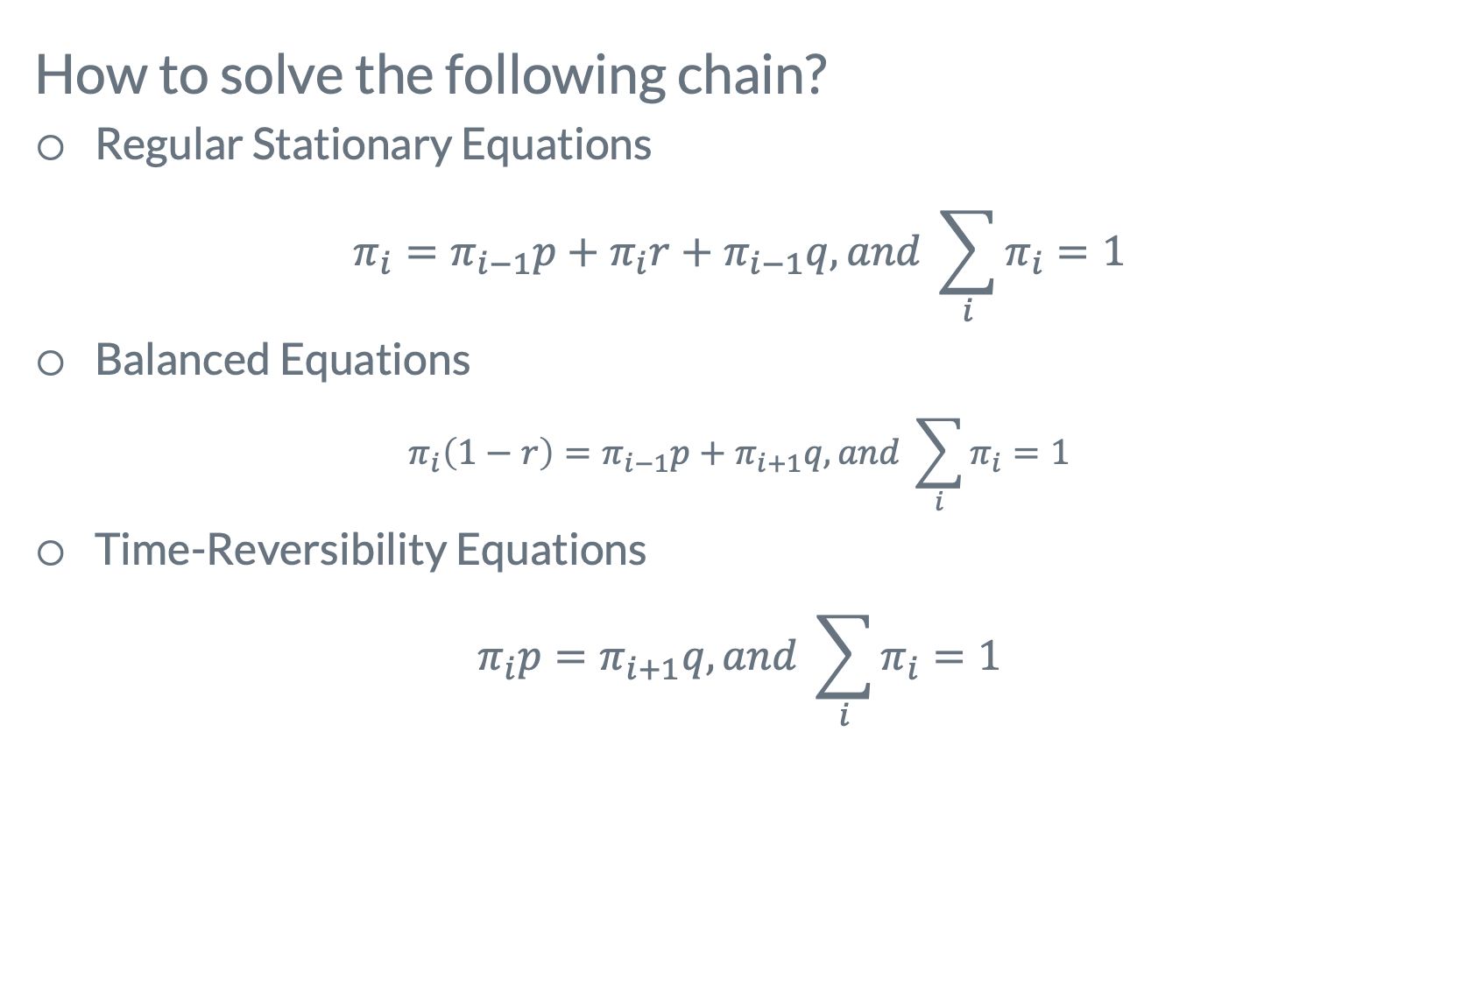
Solving DTMC with Different Views
How to solve the following chain?
Regular Stationary Equations
$$π_{i}=π_{i−1}p+π_{i}r+π_{i−1}q, and \sum_{i}{π_{i}=1}$$
Balanced Equations
$$π_{i}\left(1−r\right)=π_{i−1}p+π_{i+1}q, and \sum_{i}{π_{i}=1}$$
Time-Reversibility Equations
$$π_{i}p=π_{i+1}q, and \sum_{i}{π_{i}=1}$$
Which one is easier?
By hand?
By computer?

Slide 35
Continuous Time Models (CTMC)

Slide 36
Definition
It’s easier to build CTMC than DTMC!
Why?

Slide 37

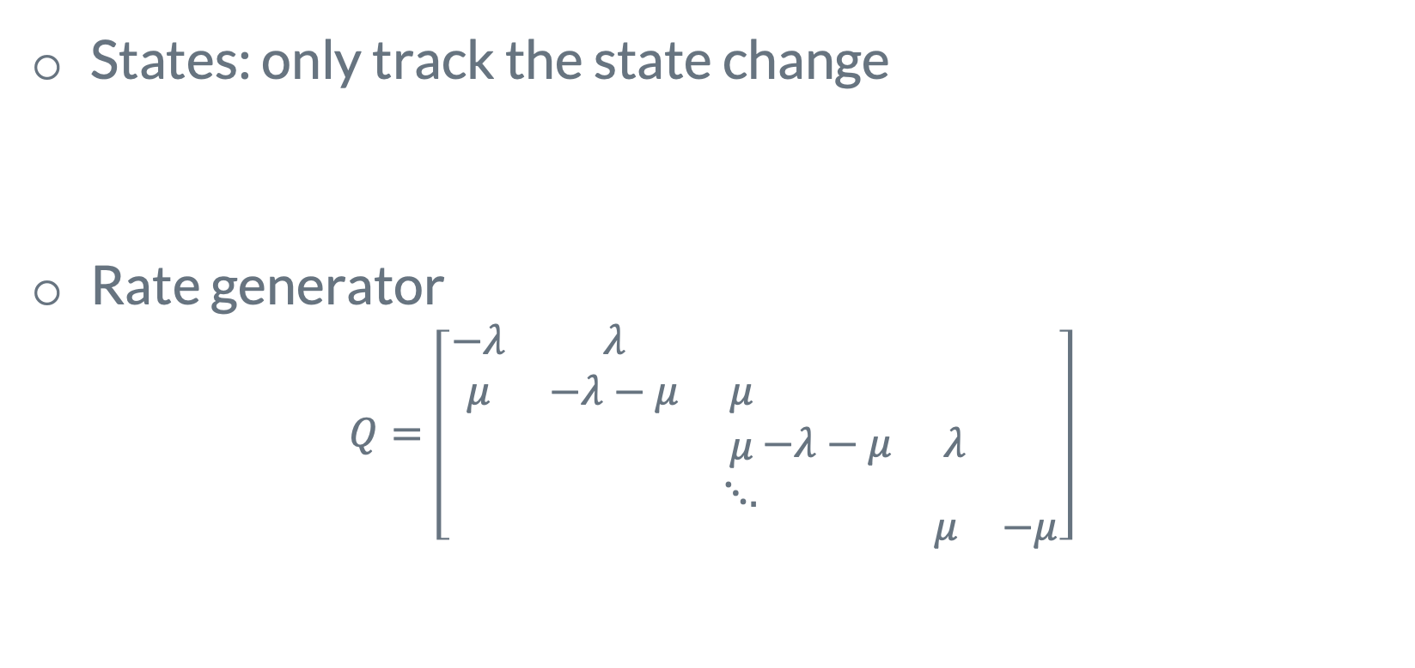
Build a CTMC model
λ=3
jobs
Μ=5
jobs
sec
sec
States: only track the state change
Rate generator
$$Q=\left[\begin{aligned}\begin{aligned}\begin{matrix}−λ & λ & \\ μ & −λ−μ & μ \\ & & μ\end{matrix}\begin{matrix} & & \\ & & \\ −λ−μ & λ & \end{matrix} \\ ⋱. \end{aligned} \\ \begin{matrix} & μ & −μ\end{matrix}\end{aligned}\right]$$
What is the difference against DTMC?
(Not transition probability)

Slide 38
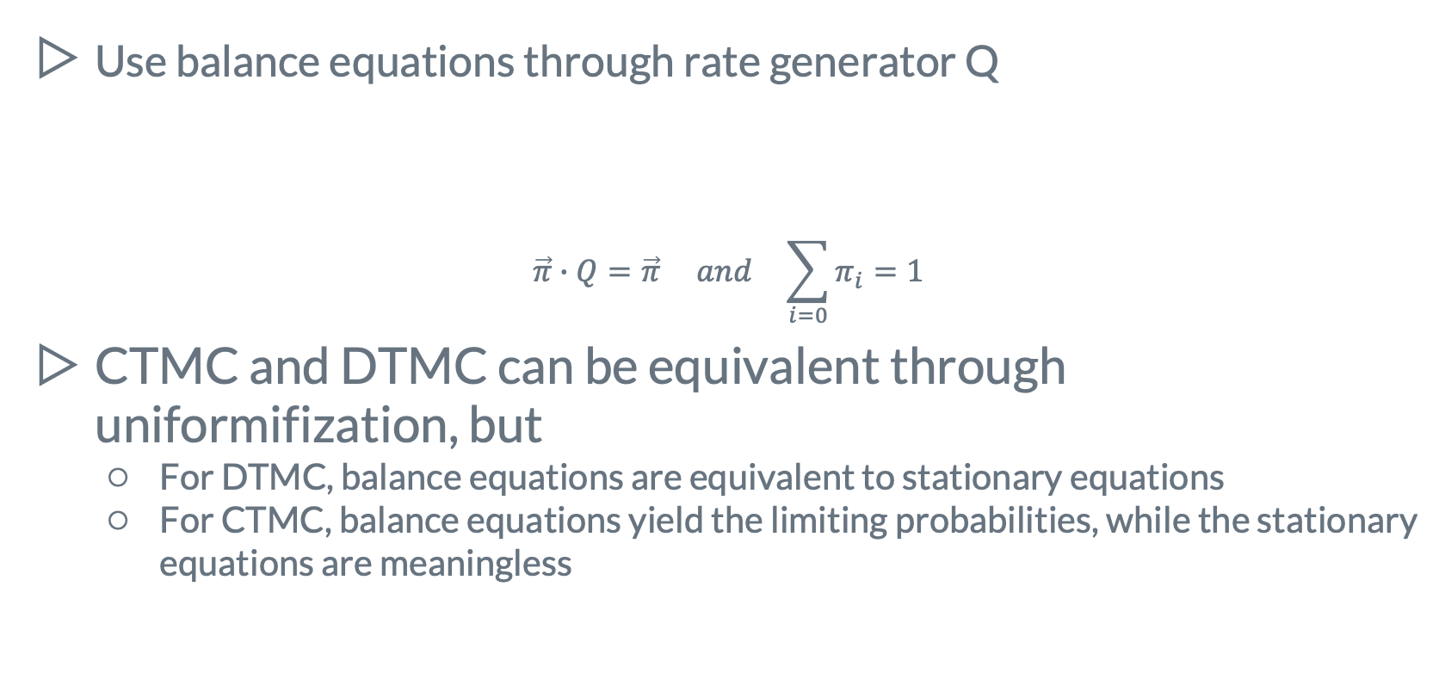
Solving CTMC
Use balance equations through rate generator Q
$$\vec{π}∙Q=\vec{π} and \sum_{i=0}{π_{i}=1}$$
CTMC and DTMC can be equivalent through uniformifization, but
For DTMC, balance equations are equivalent to stationary equations
For CTMC, balance equations yield the limiting probabilities, while the stationary equations are meaningless
Any physical meaning?

Slide 39
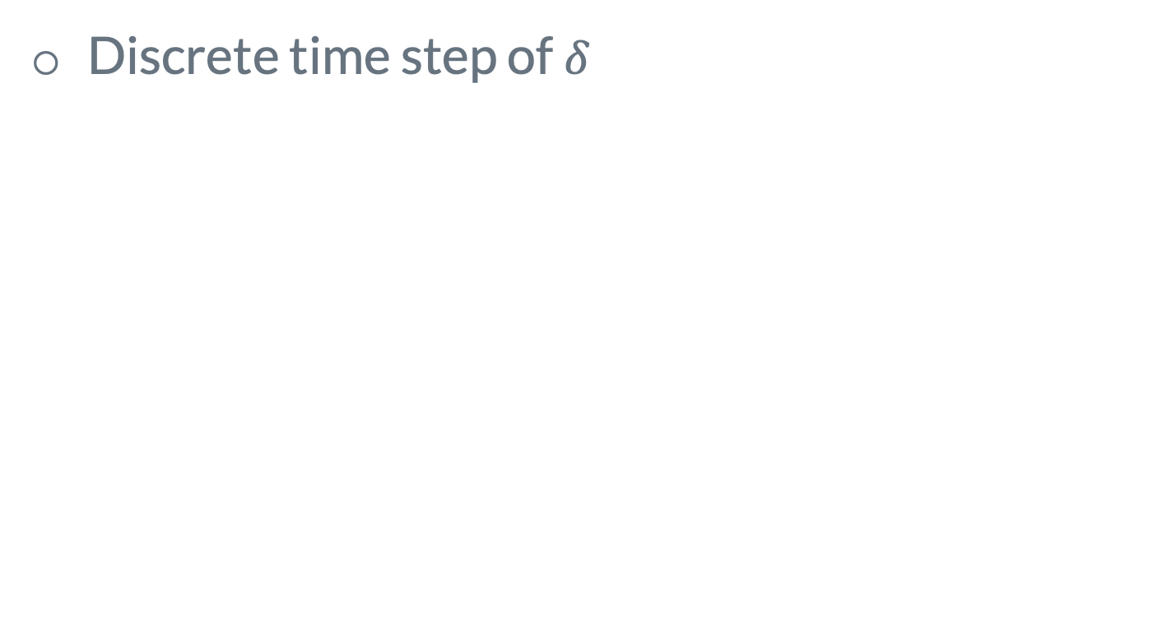
DTMC v.s. CTMC by Simple Example
Discrete time step of$δ$

Slide 40
More Example of CTMC
Machine Failure

Slide 41
Poisson Process

Slide 42
Poisson Process

Slide 43
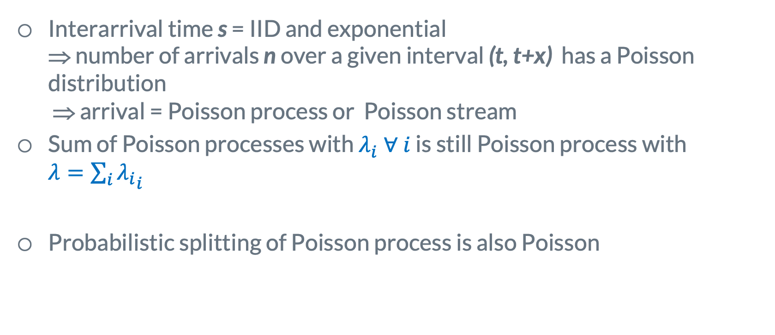
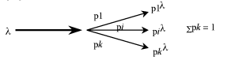
Poisson Processes
Interarrival time s = IID and exponential ⇒ number of arrivals n over a given interval (t, t+x) has a Poisson distribution ⇒ arrival = Poisson process or Poisson stream
Sum of Poisson processes with $λ_{i}^{ } ∀ i$ is still Poisson process with ${λ=\sum_{i}{λ_{i}}}_{i}^{ }$
Probabilistic splitting of Poisson process is also Poisson
Why? How to prove?
Think of exponential distribution!

Slide 44
Relationship Among Stochastic Processes

Slide 45
Bonus quiz

Slide 46
Next lecture:
Queueing Theories
(a lot of CTMC)

Slide 47
Thanks!
Any questions?
y.chen-10@tudelf.nl
lydiaychen@ieee.org

Slide 48
Presentation design
This presentations uses the following typographies and colors:
Titles: Raleway
Body copy: Lato
You can download the fonts on these pages:
https://www.fontsquirrel.com/fonts/raleway
https://www.fontsquirrel.com/fonts/lato
Dark blue #2185c5
Light blue #7ecefd
Yellow #ff9715
Magenta #f20253
Dark gray #677480
Light gray #97abbc
You don’t need to keep this slide in your presentation. It’s only here to serve you as a design guide if you need to create new slides or download the fonts to edit the presentation in PowerPoint®

Slide 49
SlidesCarnival icons are editable shapes.
This means that you can:
Resize them without losing quality.
Change fill color and opacity.
Change line color, width and style.
Isn’t that nice? :)
Examples:

Slide 50
😉
Now you can use any emoji as an icon!
And of course it resizes without losing quality and you can change the color.
How? Follow Google instructions https://twitter.com/googledocs/status/730087240156643328
✋👆👉👍👤👦👧👨👩👪💃🏃💑❤😂😉😋😒😭👶😸🐟🍒🍔💣📌📖🔨🎃🎈🎨🏈🏰🌏🔌🔑 and many more...

